Slide 1
Final submission deck
Creamble
Provided on: 20/07/2024
Returned on: dd/MM/2024

Slide 2
Dear Team,
Thank you for your great contributions to the AI4EO MapYourCity challenge. Challenges like this live because of their great community and active participation and I are happy that you chose to be part of it.
We hope you had fun, excitement and learned something whilst competing in our challenge – you can be proud of your great solutions, and I are happy to announce that you are in the top 10 of the leaderboard.
From the entire AI4EO team: Thank you for your great contributions.

Slide 3

As you have potentially qualified for one of the top three prizes, I are evaluating your submission to confirm and validate the code and approach.
Therefore, I ask you in this document to:
Present your solution approach
Explain your code
Highlight anything else of relevance

Slide 4
Your solution approach
Please tell us about your overall approach to the MapYourCity challenge
Tell us about your methods/algorithms/technologies used in your solution
Please try to be concise and max use the next two slides for this

Slide 5
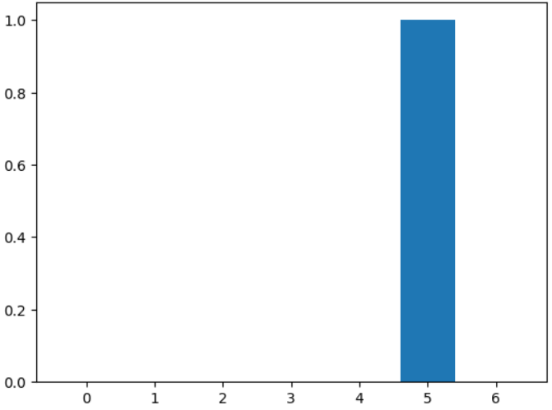
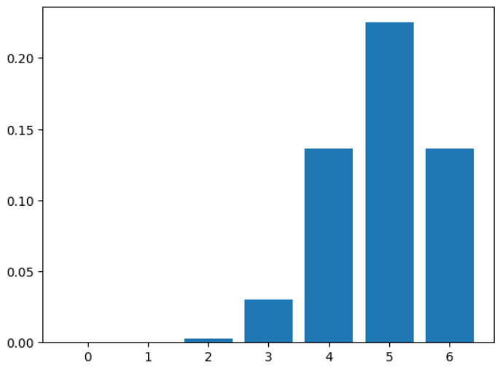
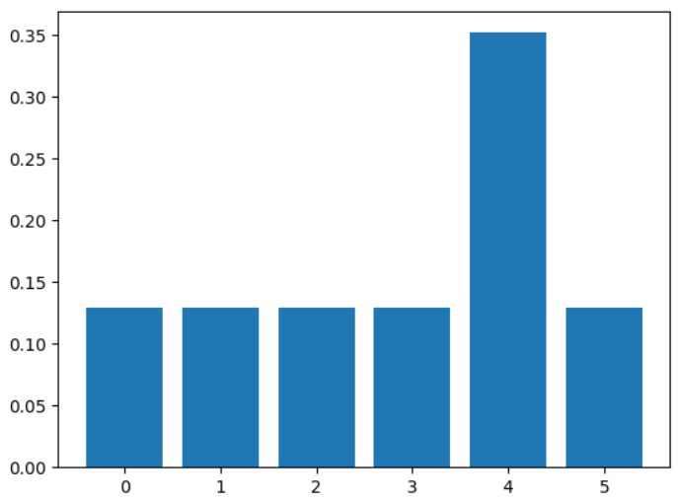
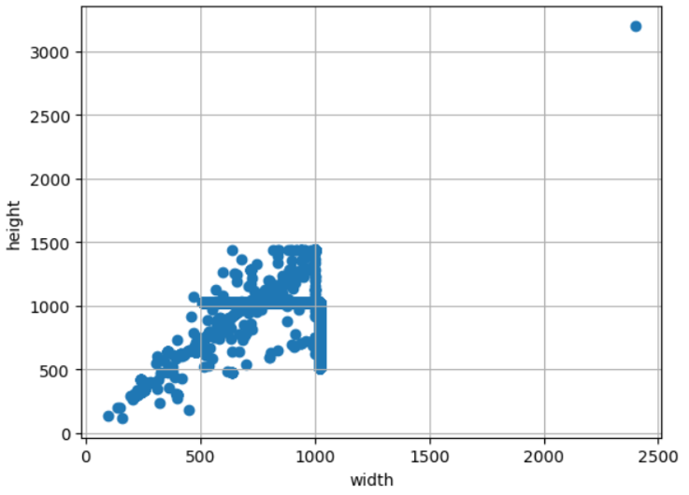
Your solution approach (1/2)
1. Label Correlation
- The label of this data is the problem of predicting the year the building was constructed. Therefore, the distance between labels indicates the time distance when the buildings were constructed, and thus there is a correlation. For example, Class 6 ">2006" is closer to Class 5 "1993-2006" than to Class 0 "<1930". Therefore, reflecting the correlation according to the distances held by the labels in the learning process was expected to be a key approach for the solution.
- Thus, the first approach I took assumed that the label distribution was composed of probabilities rather than a binary 1 or 0 distribution. I converted them into soft labels following the Gaussian Probabilistic Distribution and guided the learning to occur with KL-Divergence Loss. As a result, I obtained a small improvement in PB score. However, because the distribution of the converted labels is manually adjusted by the variant parameter, there is a cost and uncertainty involved in that part. To overcome this, I used the Label Smoothing method and achieved the best PB score improvement through it. Furthermore, through hyperparameter search, I confirmed that 0.3 is the best parameter for Label Smoothing.
PB score increased
PB score increased
< Original Hard Label >
< Gaussian Distributed Soft Label >
< Label Smoothed Soft Label >
2. Image Size Distribution
- To resize the Street View images, I first checked the distribution of the image sizes. The 2:3 aspect ratio was selected as the representative value that best represents the distribution of the sizes, and I believed that this would allow me to resize the images with minimal loss.
- In the case of Top-View and Sentinel images, the aspect ratio is 1:1, so it was considered reasonable to follow the size that the model was trained on when resizing.
3. Robustness
I observed that as the Validation Score increased, the Public Board Score also
increased. However, since this does not necessarily guarantee an increase in the Evaluation Score (Private Board Score), I took care to prevent the model from overfitting to the data.
- I actively utilized K-fold Cross Validation and designed it to be included in the Ensemble algorithm. I needed to decide on the metric for selecting the best model, and I thought that the MPA (Mean Percentage Accuracy) presented in the competition was most similar to the recall value. Therefore, I used it as the criterion for selecting the best model.
< Street-View Image Size Distribution >

Slide 6
Your solution approach (2/2)
4. Model Specification
For image classification, I used EVA, which recently achieved SOTA (State Of The Art) on ImageNet.
Since there are various types of labels, I used Stratified K-Folds to train five models (FOLDS) for each type of data (Street view, Top view, Sentinel).
For the LOSS, I applied Label Smoothing (0.3) to Cross Entropy, effectively training it in a manner close to KL Divergence.
I used AdamW as the optimizer and employed Cosine Annealing starting from a learning rate of 2.5e-05.
For augmentation, I initially used griddropout, horizontalflip, Blur, and RandAugment, but to reduce overhead from parameter search and experiment more efficiently, I used PyTorch's trivial augment.
I used the same model on the left for each dataset, and thus, I ultimately trained 15 models (3 types of data x 5 folds).
MODEL | eva02_large_patch14_448.mim_m38m_ft_in22k_in1k
Task | Classification
Stratified K-Folds | 5
Loss | Cross-Entropy
Label_Smoothing | 0.3
Optimizer | AdamW
Scheduler | CosineAnnealingWarmRestarts
Learning Rate | 2.5e-05
Image Resize | 448 Max & 2:1 ratio(Street Veiw) 448(Top-view, Sentinel)
Image Augmentation | trivial
Image Interpolation | bicubic
5. Ensemble : Multi Data & Folds Soft-Voting
The ensemble technique of the Soft-Voting method was applied to suit the structure of the competition's test dataset. There were two cases in the test dataset, and the output values ​​of the models corresponding to each case were added up after Softmax, the average was calculated, and the final predicted value was determined after argmax.
Total number of logits =
the number of data(3 or 2 ) * the number of folds(5)
Street View Image
Top View Image
Sentinel Image
Test Image Case 1 : all data
Total number of Ensemble Logits(15)
Test Image
Case 2 : no sentinel
Total number of Ensemble Logits(10)
*prediction from a single model
< Multi-Modal & Folds Ensemble with Soft-Voting Approach >

Slide 7
Explain your code
Please give us a short overview of your code as provided in your .csv submission file. What makes it work, what makes it special?
Please try to be concise and max use the next two slides for this

Slide 8
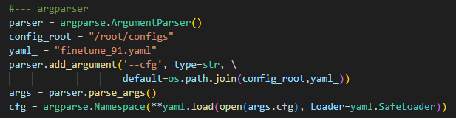
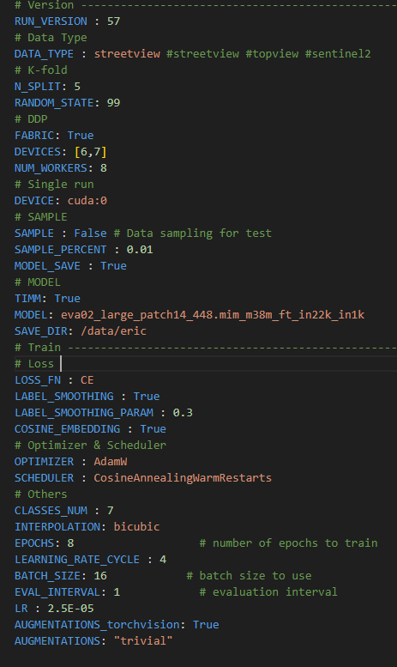
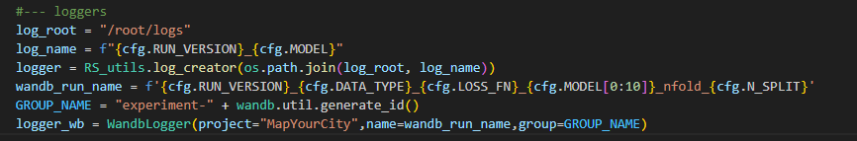
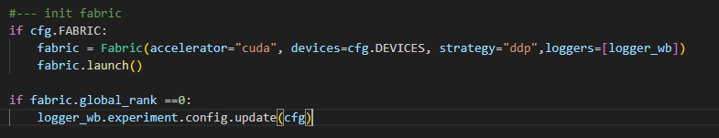
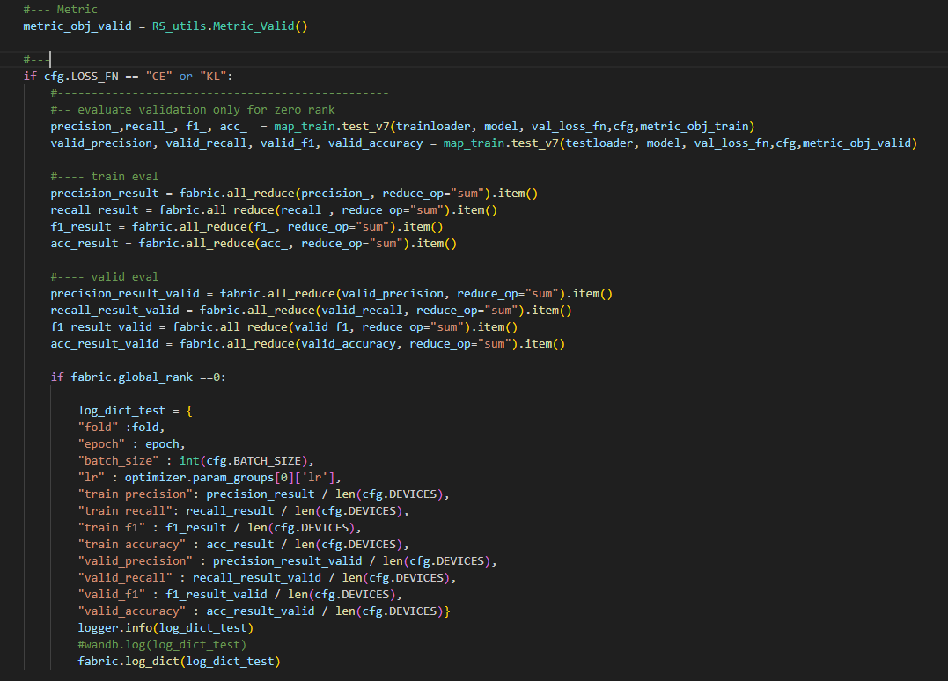
Explain your code (1/2)
< argparser >
Key concept for building code : Easy Experimentation
Configuration based code
Overview:
The purpose of building the code for this competition was to make hyperparameter searches easy for all options. As shown on the right, the code was designed so that major blocks in deep learning can adapt well to experimental environment changes and these changes can be tracked.
Therefore, I put a lot of effort into ensuring that logs from code execution are well recorded and saved. Logs were recorded both locally and online, and I actively utilized wandb for online logging.
Additionally, during validation, I performed distributed validation using multiple GPUs. To aggregate the metric results for this part, I actively utilized the all_reduce function of the torch-lightning fabric module.
The main libraries used were pytorch, torch lightning fabric, and wandb.
< K-folds >
< Logger >
< Distributed Learning Setting >
< Parameter & Setting Control >
< Configuration file (.py) >
< Distributed gpu logs for validation >

Slide 9
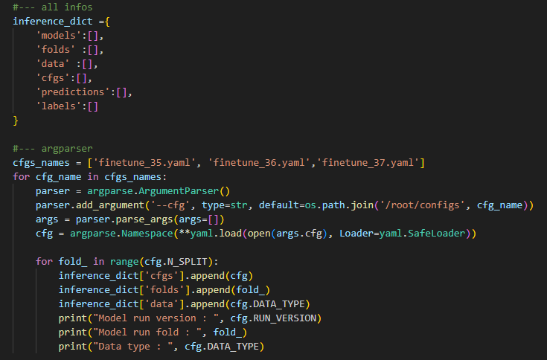
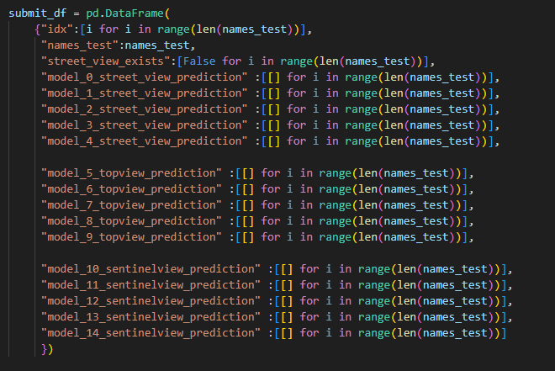
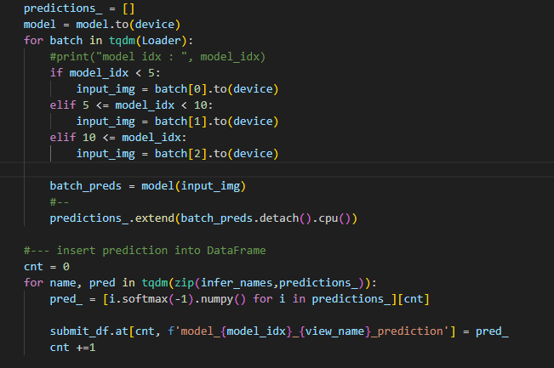
Explain your code (2/2)
Inference & Ensemble Code
Overview:
For the ensemble of trained models, I actively utilized the soft-voting method. Since models were trained for each data type (Street view, Top view, Sentinel), I loaded the configuration files used for training each data type.
Based on the Validation Score (Recall), I selected the model with the best score for each fold as the representative model for that fold.
After applying Softmax to the logit values of each model, I performed soft-voting. Then, I determined the prediction label through argmax.
< Configurations for Inference & ensemble >
Street View x 5
Top view x 5
Sentinel x 5
< find best model for each fold and inference test data >
< all predicted logits >
< Ensemble by soft voting for all folds >

Slide 10
Further comments
In this slide you can add other information that was not covered by the previous questions, but you consider it important to mention.
Please try to be concise and max use the next slide for this

Slide 11
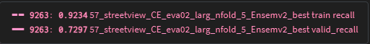
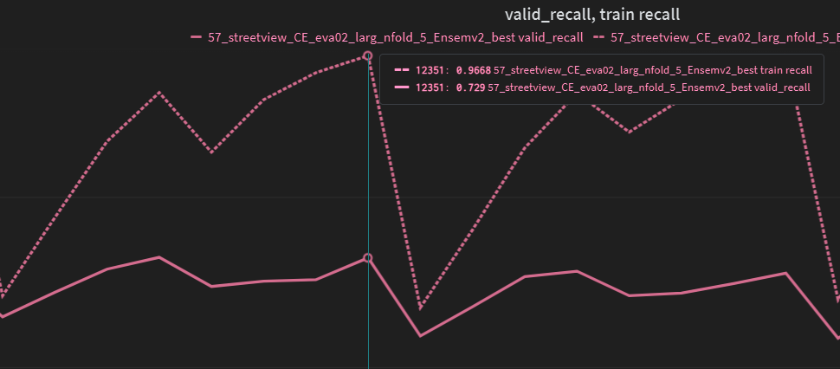
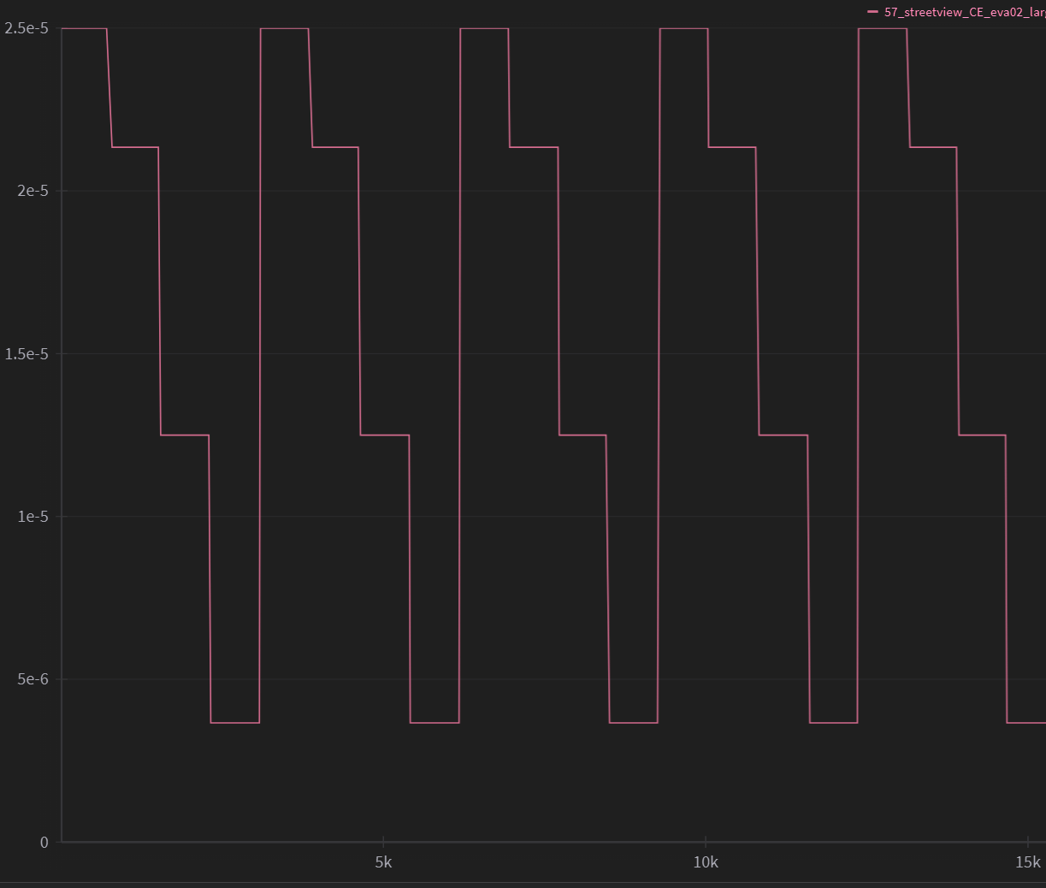
Further comments
Comments:
Optimization method
When training for a total of 8 epochs with a fixed learning rate, the highest Validation Recall value appears once at early epoch 4 and once at late epoch 7. The difference between these two optimization points is the gap between train recall and validation recall. For example, the validation scores for epoch 4 and epoch 7 are 0.7297 and 0.7290, respectively, which are almost identical. However, the train recall values are 0.92 and 0.96, showing a significant difference. Thus, in the latter case, the possibility of overfitting could not be ruled out. However, the phenomenon of higher validation scores at early epochs did not consistently appear across all folds. Therefore, by using CosineAnnealingWarmRestarts to change the learning rate at regular intervals, I aimed to prevent getting stuck in local minima or overfitting to the training dataset as much as possible. The use of AdamW was also in a similar context.
Other Techniques
In addition, I have many experimental results derived from “multi-modal layers” and “ensemble techniques.” If I win an award, we would like to share a lot of this content with ai/ml engineers at the workshop. Thank you to the platform for hosting such a wonderful competition.
Experiment logs and graphs
< Street-view best model training logs >
< CosineAnnealingWarmRestarts >

Slide 12
Please tell us your contact details so I can effectively communicate with you on the next slide
Please share the name and surname of all team members.
Please share the affiliation (university, company, institution, …) of all your team members.
Please share the contact email of your team used for sign-up.
By providing us your personal information and sending us back this presentation you confirm to have read and agreed to the privacy policy and terms & conditions which apply for the AI4EO challenge. Reasoning for data collection: Contact to team leader for submission evaluation.

Slide 13


Please tell us your contact details so I can effectively communicate with you
Team leader / point of contact
Other team members
Name : Eric (JaeWan Park)
Affiliation : TelePIX (https://telepix.net/)
Email : eric.park@telepix.net
No other team members …
By providing us your personal information and sending us back this presentation you confirm to have read and agreed to the privacy policy and terms & conditions which apply for the AI4EO challenge. Reasoning for data collection: Contact to team leader for submission evaluation.

Slide 14

Next steps and questions
Please send us the information back by Sunday 28 July 2024
Get in touch at hello@ai4eo.eu

Slide 15



Thank you for being amazing :)

